Slide 1
Hard disc
Michael 3778
Kevin 3894
Gay 3769

Slide 2
What is hard disc

Slide 4
The structure of hard disc
Head
Track
Sector
Cylinder

Slide 6
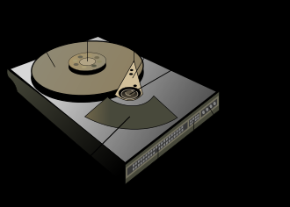
The theory of hard disc
Modern hard discs uses magnetic recording to change the direction of magnetization on the disk in order to store bits of data sequentially.
This process is done by the magnetic head
The disk spin at either 5400 rpm or 7200 rpm
in most consumer-grade

Slide 7
The theory of hard disc
The disk is separated into many small layers, each layer has a magnetic head in order to write/read

Slide 8
Different protocols
ATA: Advanced Technology Attachment
IDE: Integrated Drive Electronics
RAID
SATA (I, II, III)
SCSI
Fiber Channel
SAS

Slide 9
Thanks for watching

